Slide 1
Audio Pattern Recognition - Emotion Classification
Alan Cai, Ali Saleh, Manraj Singh, Mekdes Teklehaimanot
Notes:
Alan

Slide 2
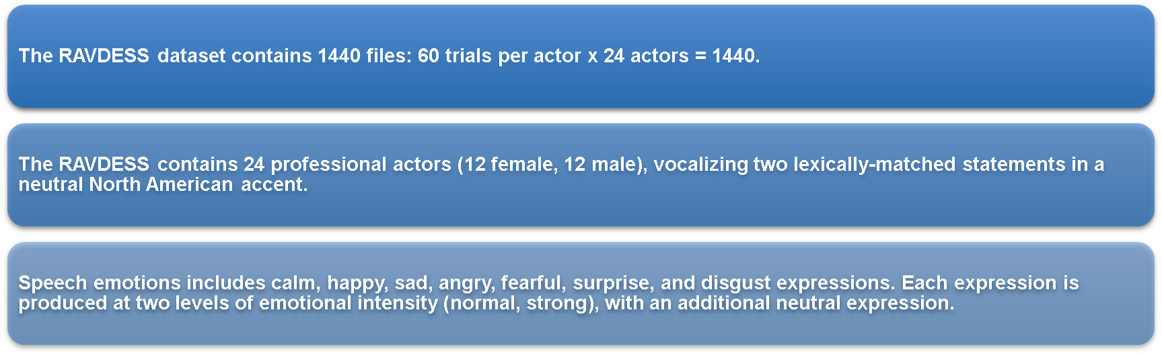

RAVDESS Dataset
Samples:
Angry Calm Sad
Notes:
Alan

Slide 3

Goal & Motivation
Goal: To build a robust and accurate audio pattern recognition system that can identify different emotions from audio data. The approach will utilize various machine learning models including MLP, SVM, RNN, and CNN to explore which model works best for this task.
In addition to comparing the performance of different models, we will explain the underlying workings of the CNN model used for audio classification, and on the key aspects that drive its decision-making process.
Motivation: Our motivation is to address the increasing need for emotion recognition in various fields, such as mental health, customer service, entertainment, and virtual assistants. Developing a robust and accurate system will facilitate more natural and effective communication between humans and computers, leading to better decision making, improved user experiences, and more personalized interactions across multiple industries.
Notes:
Alan

Slide 4
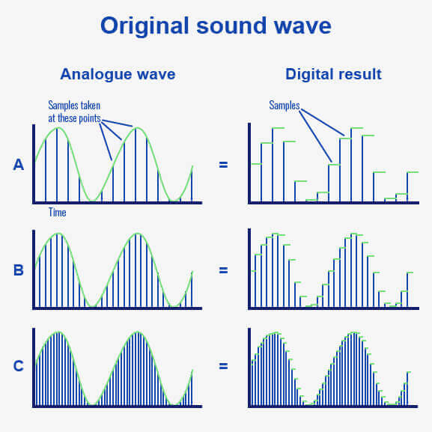
Raw Audio Data
Using the librosa python module, the RAVDESS audio samples were loaded using their original sample rate (44100 Hz). Raw audio data consists of a continuous sequence of digital samples that represent the amplitude of an audio signal at specific points in time. These samples are taken at a fixed rate called the sampling rate, in this case 44,100 samples per second.
Higher sampling rates result in a more accurate representation of the original analog audio signal.
Notes:
Mekdes

Slide 5
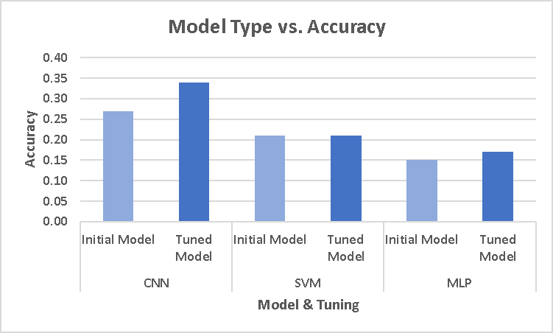
Raw Data Models
Each of these models were trained and evaluated on the raw audio data to determine their classification accuracies.
The results showed that the CNN model outperformed the other models with the highest accuracy and improvement.
Tuning the hyperparameter has improved the accuracies for all the models.
RNN was not feasible for the raw data due to the high dimensionality (253,053) and complex temporal structure of the data, making the input sequences too long and computationally expensive to train the model.
However, all models had relatively low accuracies indicating the raw audio data alone is not sufficient for accurate emotion recognition, and that steps such as feature extraction and data augmentation would be investigated.
Notes:
Mekdes

Slide 6
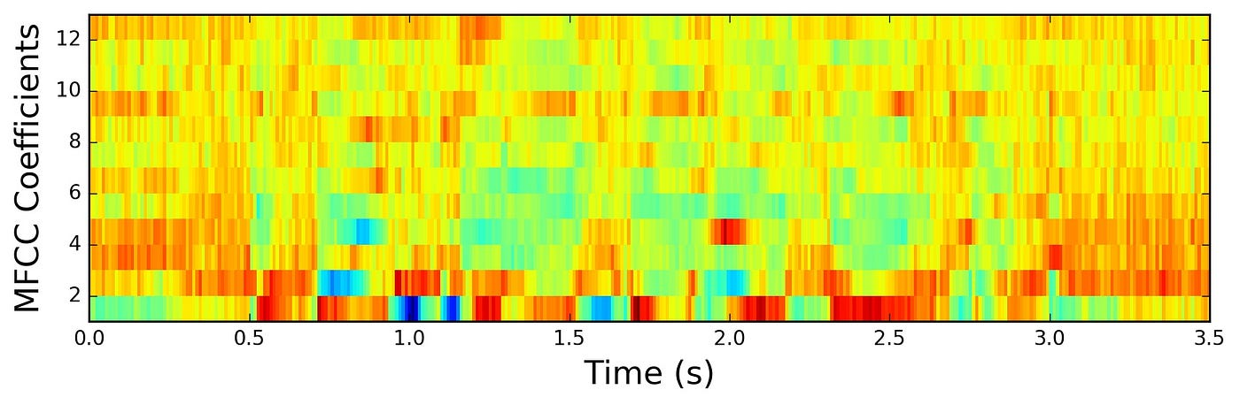
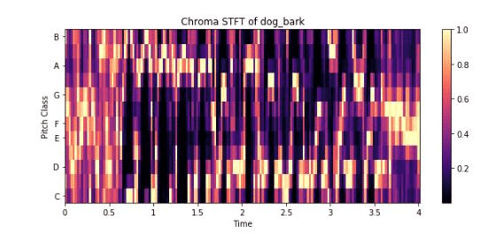
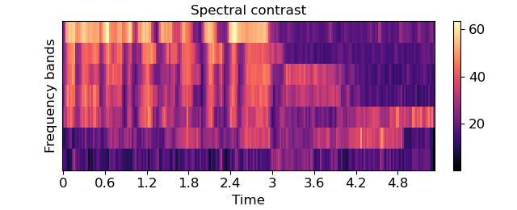
Feature Extraction
Three types of features that are commonly used in audio analysis and have been found to be effective in previous studies* for speech emotion recognition are MFCC, chroma, and spectral contrast.
MFCC captures the distribution of the power across different frequency bands, emphasizing the frequencies that are most relevant for human speech perception.
Chroma features represent the distribution of energy across different pitch classes (notes) within an octave. They help capture the variations in pitch and intonation.
Spectral contrast measures the spectral differences between a sound signal and its background noise, which can provide information about the sharpness and clarity of the sound.
Chroma STFT
Chroma STFT
*ERANNs: Efficient residual audio neural networks for audio pattern recognition Verbitskiy et al. - Pattern Recognition Letters - 2022
*Speech Emotion Recognition Using MLP Classifier Poojary et al. - International Journal of Scientific Research in Science and Technology - 2021
Notes:
Ali
The modeling of raw audio data was limited due to the complex nature of the data. Thus, feature extraction was necessary in order to improve model performance.
Discuss different models attempted (deep learning vs. non-deep learning (SVM)
Discuss their pros and cons in relation to audio data
Why went with CNN in the end

Slide 7
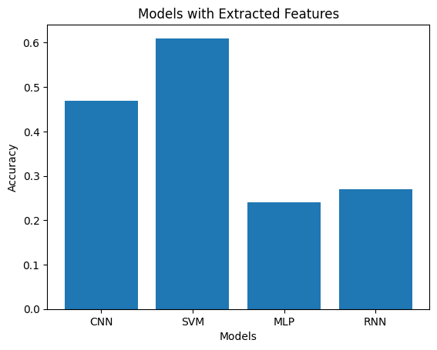
Initial Feature Extracted Models
The SVM model showed the best performance initially when classifying emotions, which could be attributed to the fact that the RAVDESS dataset is relatively small, which makes the simpler model structure of the SVM less prone to overfitting.
However, despite the initial success of the SVM, the CNN model was still used for further experimentation, as it is a better choice for more complex problems.
CNNs perform well with audio data*, especially with complex patterns, they are robust to noise, and are more invariant to translation making them advantageous for different datasets and applications.
*ERANNs: Efficient residual audio neural networks for audio pattern recognition Verbitskiy et al. - Pattern Recognition Letters - 2022
Notes:
Ali
Hierarchical feature learning: CNNs can learn hierarchical features by stacking multiple convolutional layers. Each layer in a CNN captures increasingly complex patterns from the input data, allowing the network to build a robust understanding of the emotional content in the audio signals.
Reduced complexity: By using convolutional layers and pooling layers, CNNs can significantly reduce the complexity of the model compared to a fully connected neural network. This results in a more efficient model with fewer parameters, which can help prevent overfitting and improve generalization to new data.
Robust to noise: Audio data can be noisy, and CNNs have demonstrated robustness to noise in various applications. The convolution and pooling operations help the model focus on the most important features while being less sensitive to noise in the input data.

Slide 8
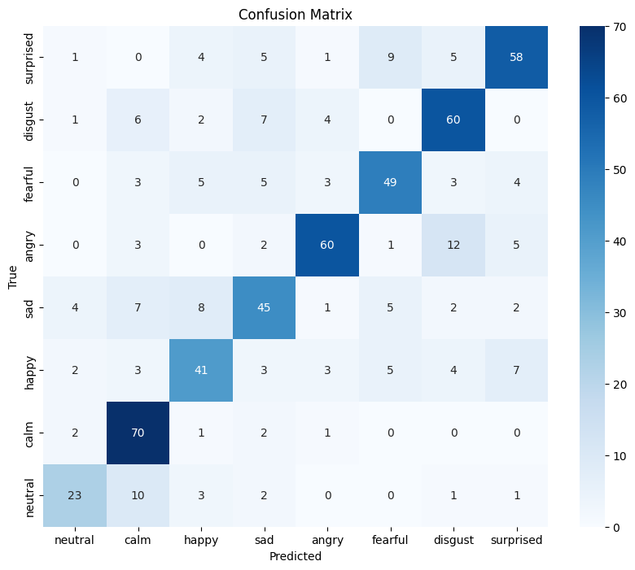

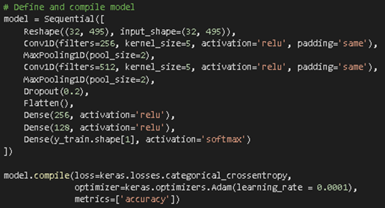
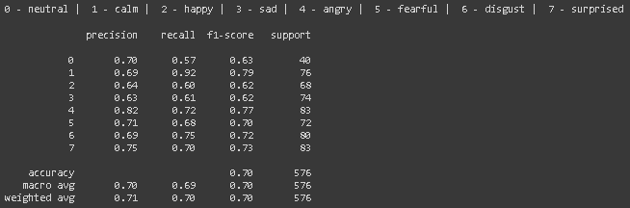
CNN Model
Notes:
Manraj

Slide 9
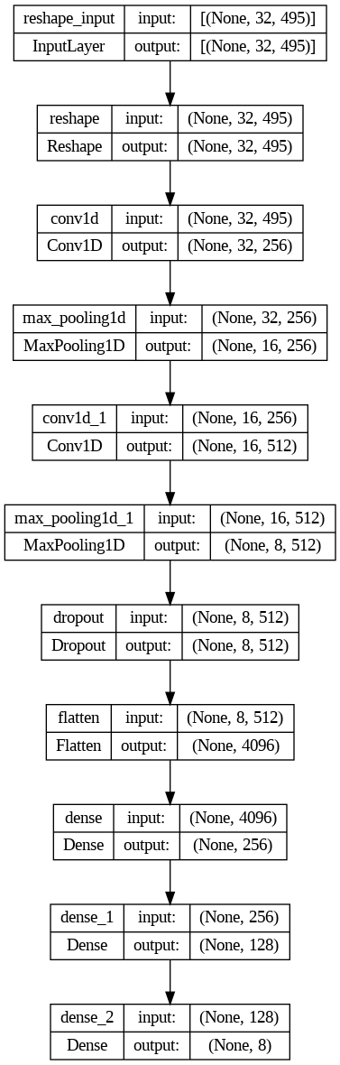
Explaining CNN Model
Conv1D (1st): This is the first 1D convolutional layer with 256 filters. It learns local patterns in the input features by applying multiple filters (kernels) along the time axis. Each filter detects a specific pattern in the input, helping the model capture important information from the audio features for emotion classification.
MaxPooling1D (1st): Reduces spatial dimensions, extracting significant features and lowering computational complexity.
Conv1D (2nd): Learns more complex patterns using 512 filters, capturing nuanced information from audio features.
MaxPooling1D (2nd): Further reduces spatial dimensions, extracting significant features and reducing computational complexity.
Flatten: This layer flattens the 3-dimensional tensor output from the previous layer into a 1-dimensional tensor. This is necessary for connecting the convolutional layers to the fully connected (dense) layers.
Notes:
Alan
The purpose of the convolutional layers is to learn local patterns in the input features, (MFCC, Chroma, and Spectral Contrast)
They utilize filters to detect different patterns which are small weight matrices that slide over the input data, performing element-wise multiplication and summation. Each filter is designed to detect specific frequency patterns in the audio signals. The first convolutional layer in this model uses 256 filters, while the second one uses 512 filters. As the filters move through the layers, they learn more complex and abstract patterns, enabling the model to capture nuanced information from the audio features.
Pooling layers, such as max-pooling layers, are used to reduce the spatial dimensions of the input tensors while preserving important information. By taking the maximum value in non-overlapping windows along the time axis, these layers downsample the data, extracting the most significant features from the convolutional layers.

Slide 10
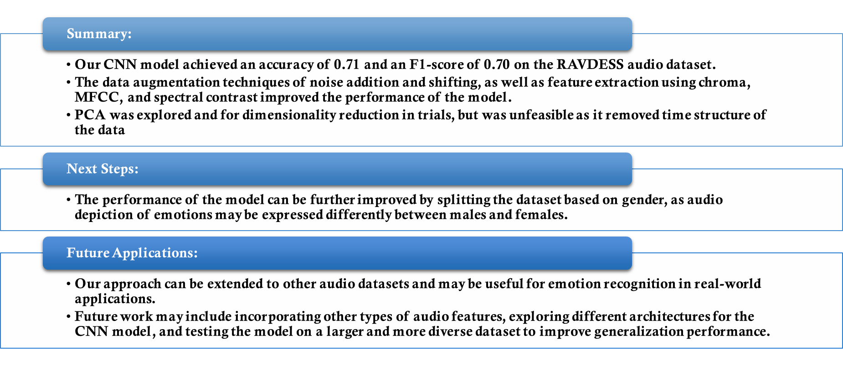
Conclusion
Notes:
Manraj

